Slide 1
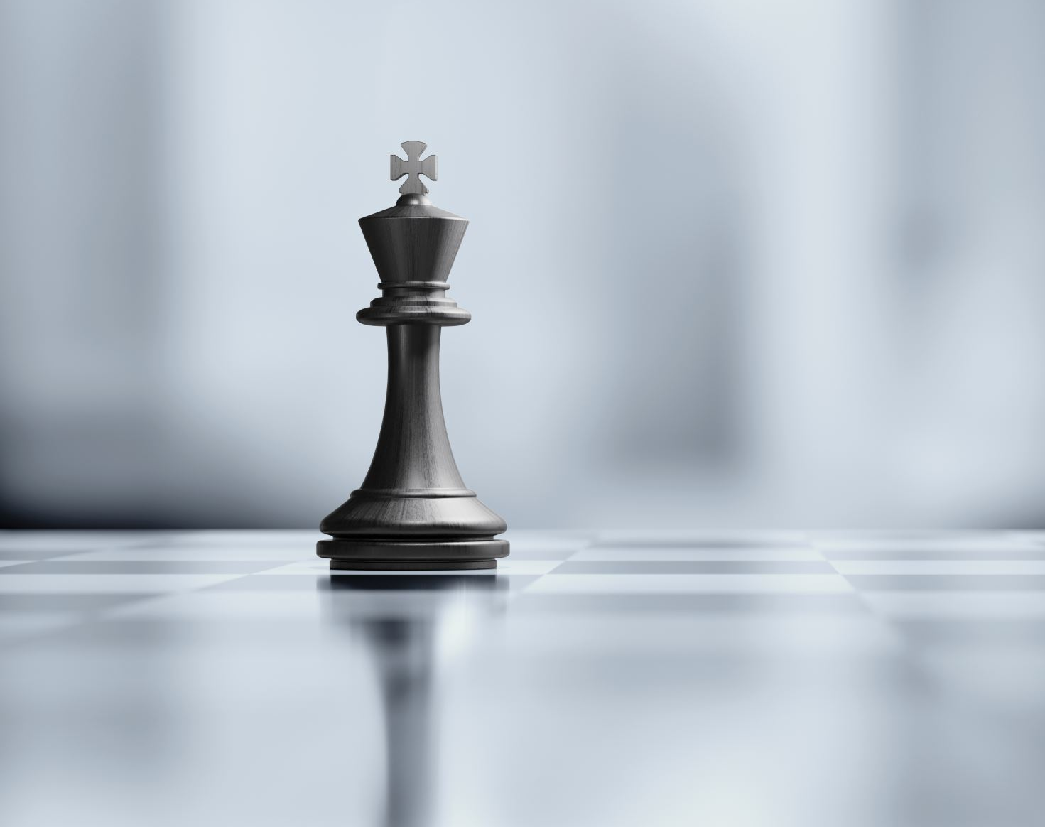
Chess Engine with Neural Network
Dikshyant Acharya
08.01.2024

Slide 2


Project Overview
Objective :
Approach:
Evaluation of chess board position by neural network
Chess board position as Input data
Evaluation of board position with Neural network
Playing the best move within certain depth of search tree
Piece movement based on evaluation of position
Collecting data at end of game
Training of Neural Network

Slide 3
Literature
Mastering Chess and Shogi by Self-Play with a General Reinforcement Learning Algorithm [1DeepMind, 6 Pancras Square, London N1C 4AG]
https://github.com/geohot/twitchchess
https://github.com/zjeffer/chess-deep-rl
Avialable Chess Engine:
Stockfish
Alphazero

Slide 4
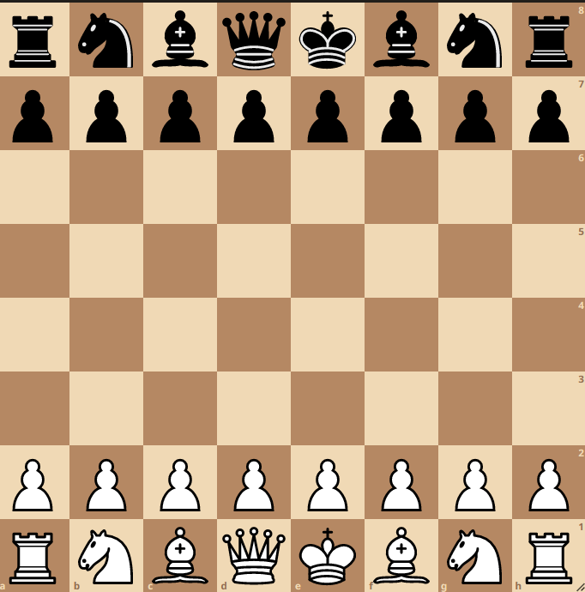
Board position
Total chess - boxes: 8 * 8
Things to consider in a position:
Every chess piece ( 12 )
4 castling rights (4 )
Moving side (1)
Board Representation in array → 8 * 8 * 17

Slide 5
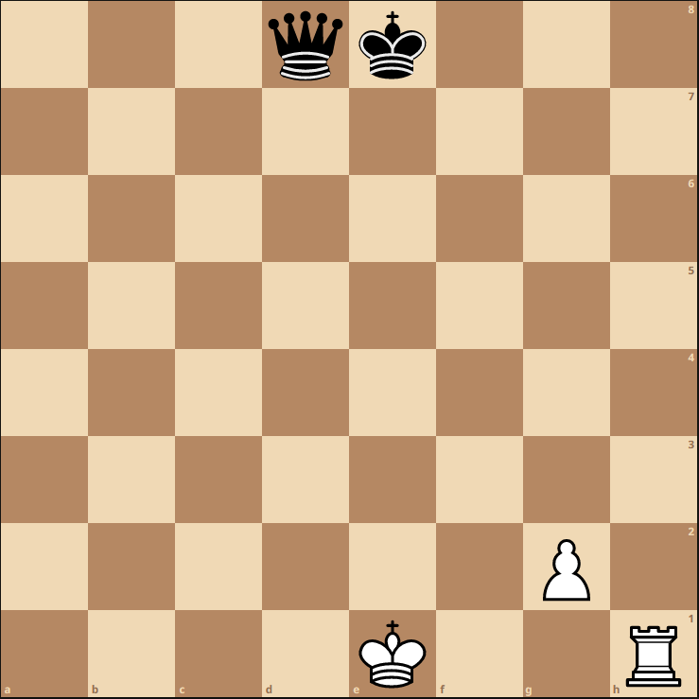
Chess Board as an Array
[[[0, 0, 0, 0, 0, 0, 0, 0, 0, 0, 0, 0, 1, 0, 0, 0, 1],
……….. [0, 0, 0, 0, 0, 1, 0, 0, 0, 0, 0, 0, 1, 0, 0, 0, 1],
……….. [0, 0, 0, 1, 0, 0, 0, 0, 0, 0, 0, 0, 1, 0, 0, 0, 1]], [[……... ]], [[……….. ………..]]]

Slide 6
Dataset
Chess Board Position -> Single Data
Label given at end of game
Every position labeled as follows:
+1 if white wins
0 if draw
-1 if black wins
Save in csv files

Slide 7
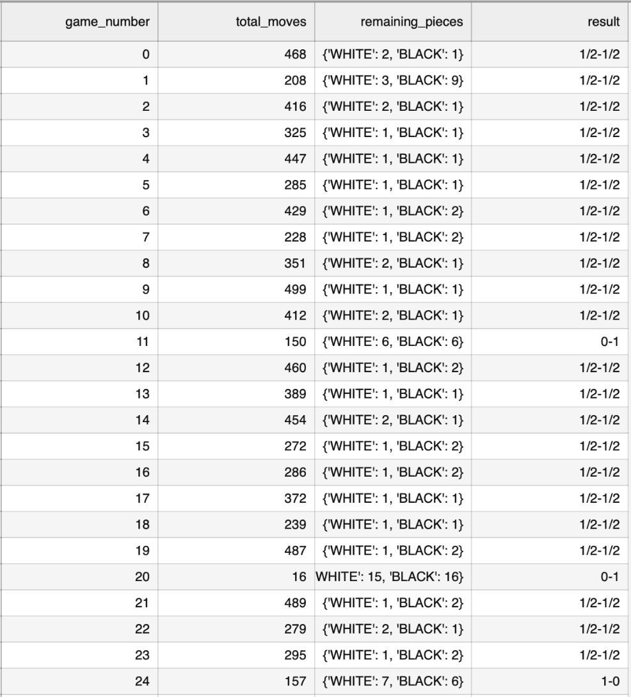
CSV-Dataset ( Game Statistics )

Slide 8
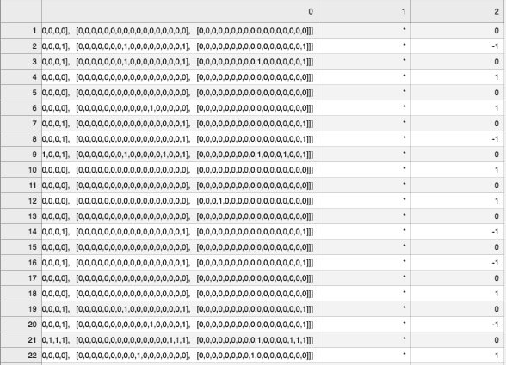
CSV-Dataset ( Checkmate Position )

Slide 9
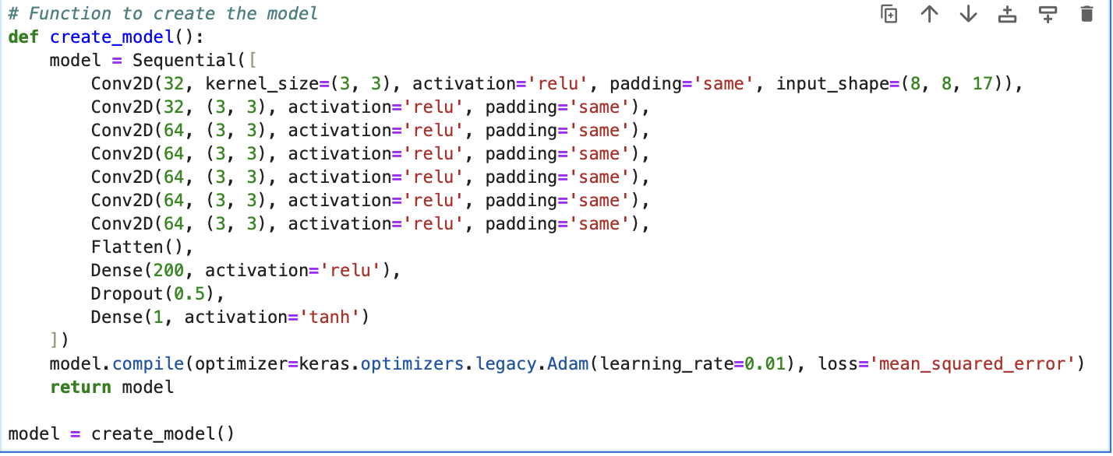
Model
Convolutional Neural Network
Purpose:
Capture following features:
Pawn advancement
King Safety
Centre Control
Output: Between -1 and 1

Slide 10
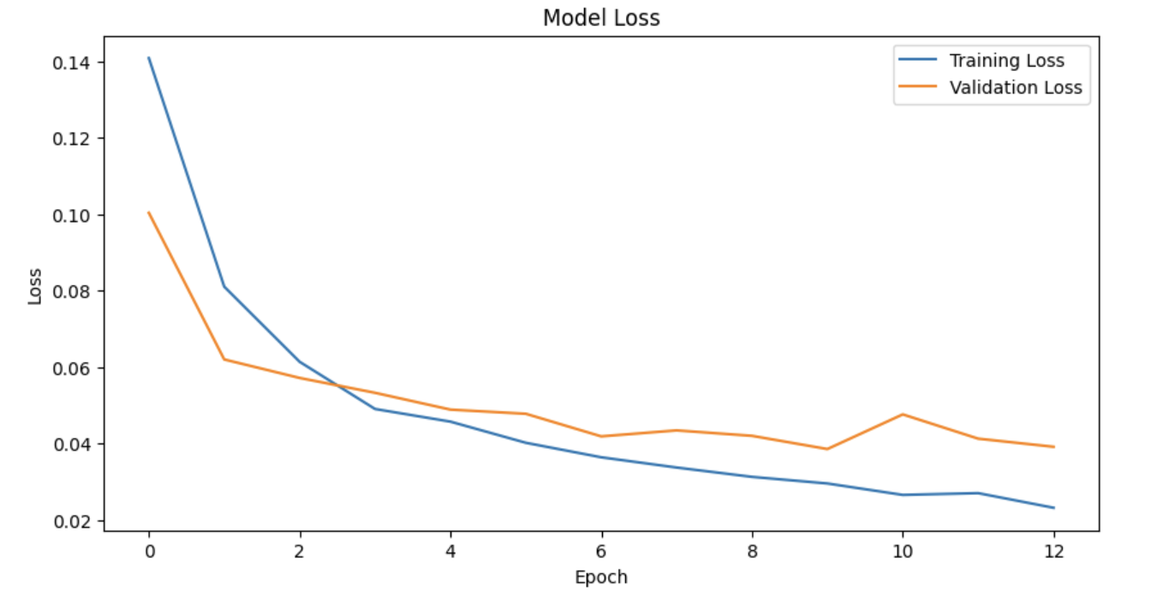
Checkmate-Model Result
Learning Rate: 0.001
Batch Size: 64
Optimizer: Adam Optimizer
Total Datasets = 61,000
Loss = mean_squared_error
Early stopping on val_loss, patience = 5
Test Loss = 0.041

Slide 11
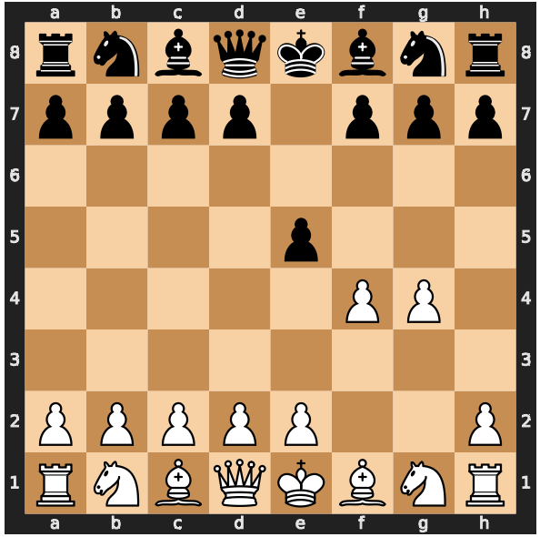
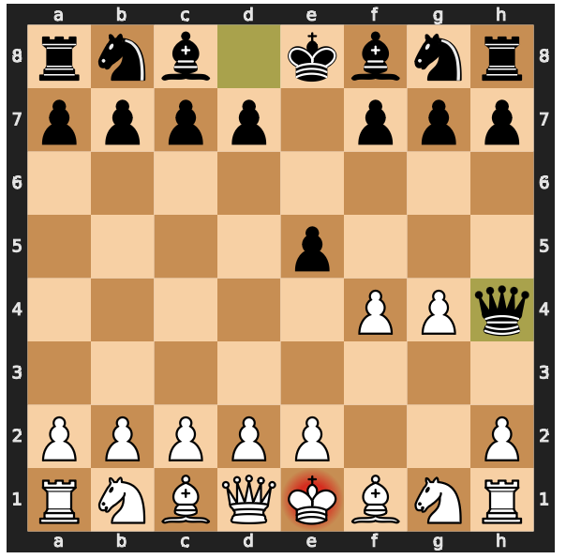
Checkmate Model Example
Black to move

Slide 12
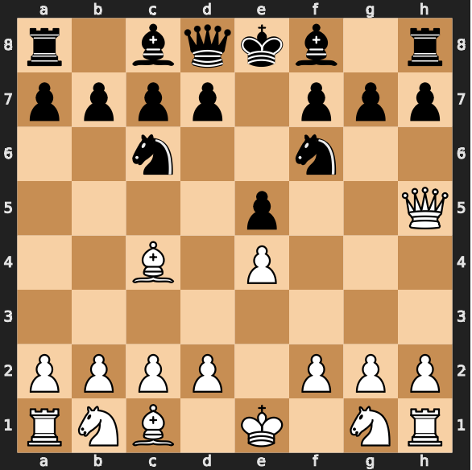
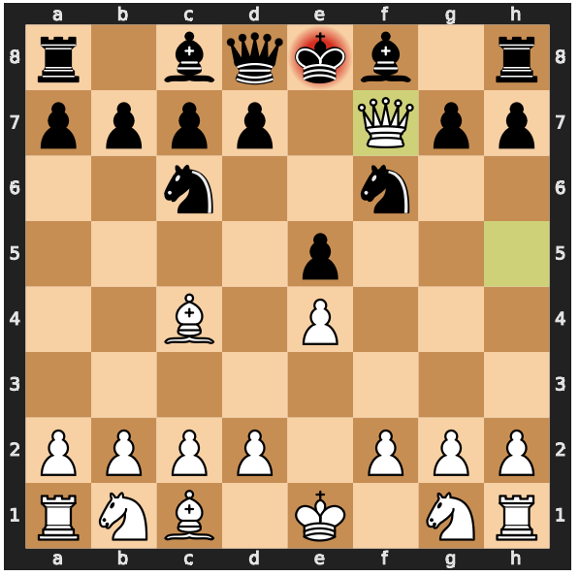
Checkmate Model Example
White to move

Slide 13
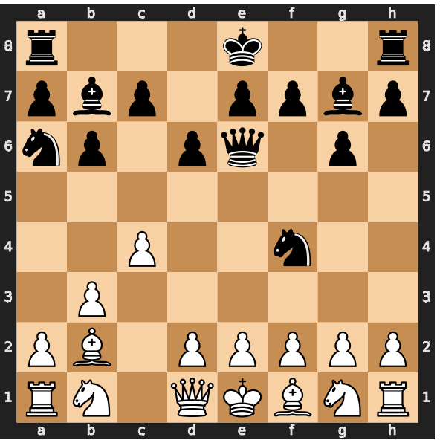
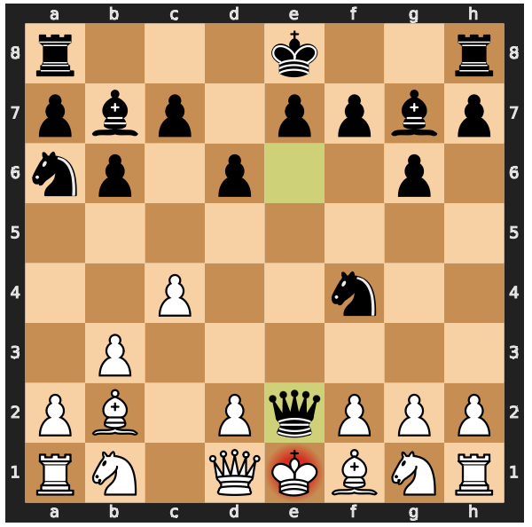
Checkmate Model Example (Failure)
Black to move

Slide 14
Challenges
Repetition of game
Repetition of moves leading to draw
Long Time for calculation
→ Choosing random move rather than calculating
Large number of drawn games
→ Saving the game considering the proportion of win, draw and loss

Slide 15
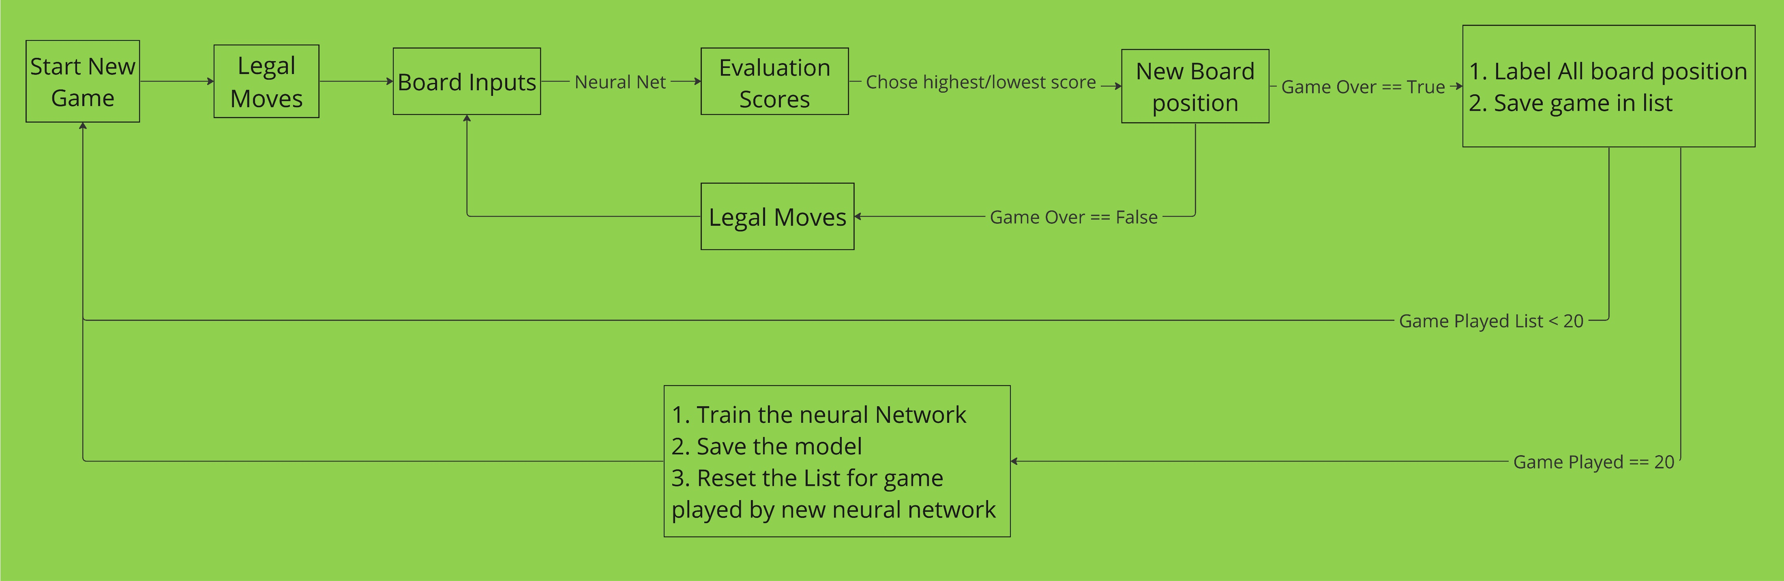
Chess with Reinforcement Learning

Slide 16
Challenges
Repetation of game
→ Make one random choice of move at one random turn → Update the neural network immediately if the game repeats.
Repetition of moves
→ Making second best move if same board position occurs
Long Time for neural calculation
→ Calculating only one move ahead
Large number of drawn games
→ Saving the game considering the proportion of win, draw and loss

Slide 17
Result
Calculation took long time to complete single game
300 moves per game = 300 * 30 position calculations = 9000 position evalution by neural network
Most game were drawn
Only small dataset was extracted (20 games)
Training the dataset didn‘t give good chess model

Slide 18
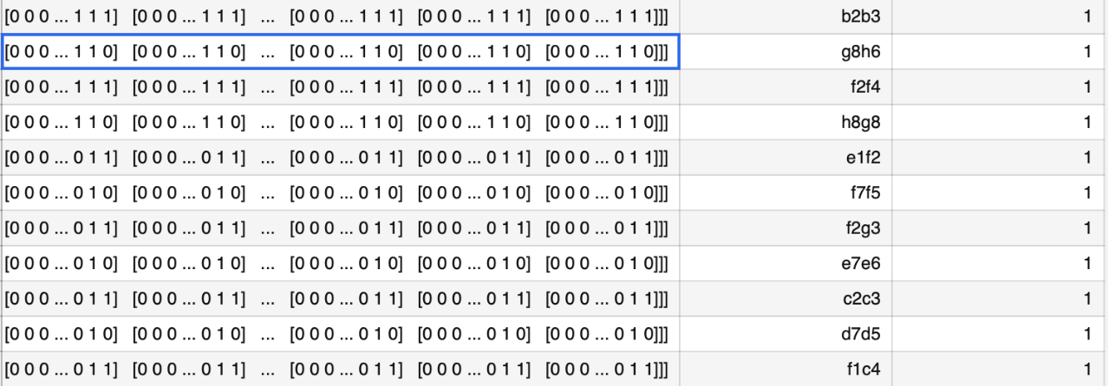
CSV-Dataset ( All Game Position )

Slide 19
Self Criticsim and Improvement Possibility
Acquiring more datasets
Model giving two outputs ( Alphazero Implementation)
Probablity of winning for each possible move
State(Value) of a given position
Enabling possibility of parallel playing of the games
Improvement in labeling of the datasets

Slide 20
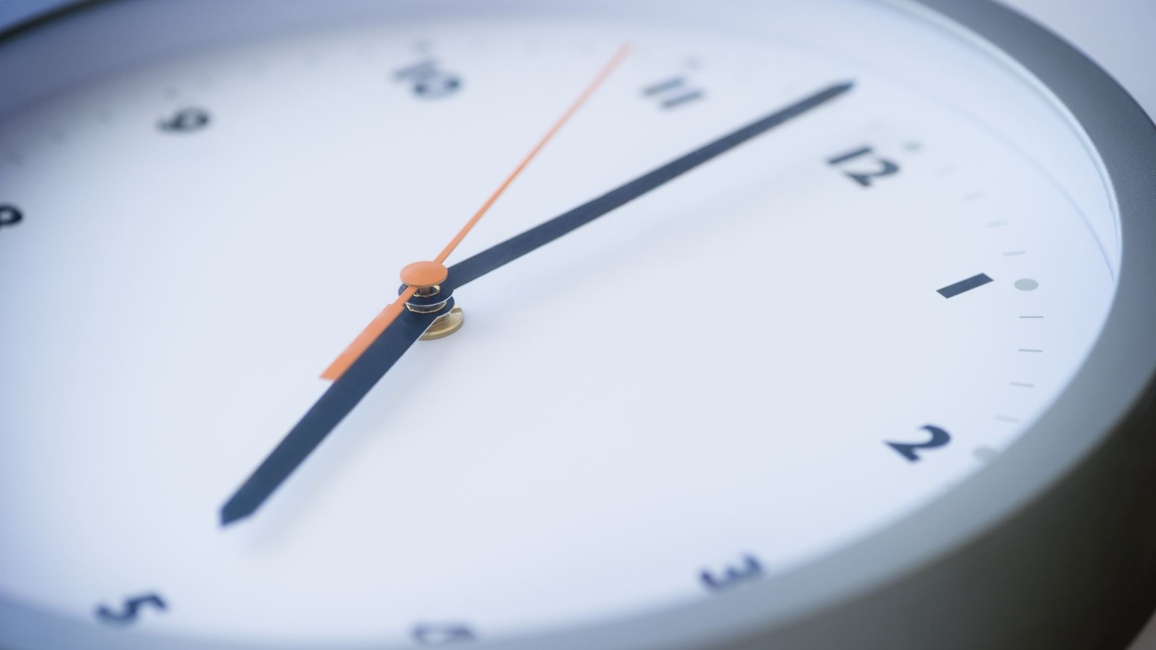
THANK YOU FOR YOUR TIME

